Slide 1
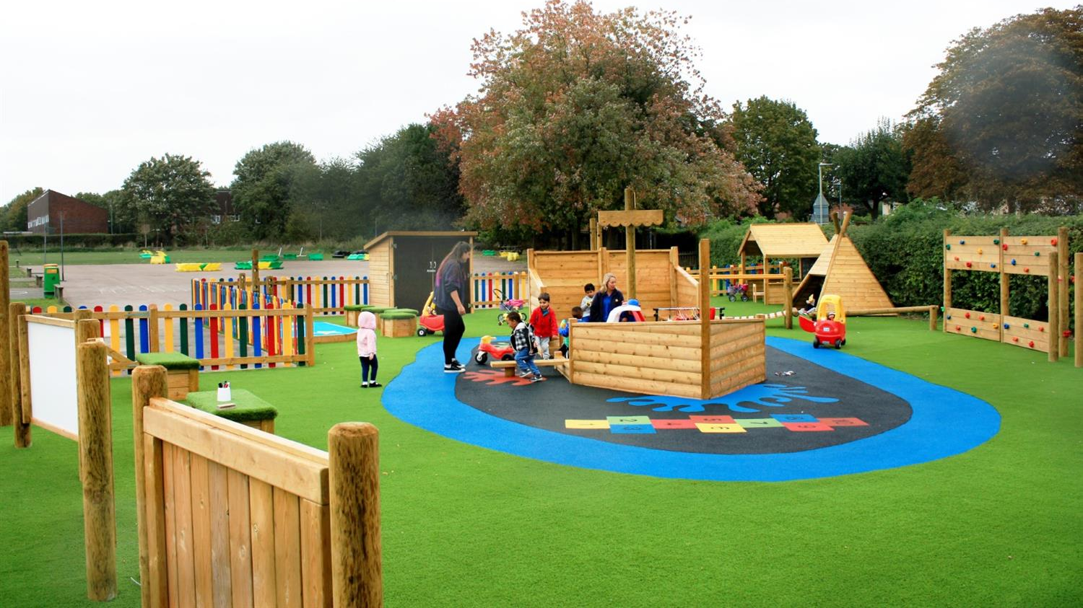
Kindergarten System Project

Slide 2
Team Family always wins
Boyan Grigorov Binev - BGBinev18@codingburgas.bg
Stoicho Tomov Chakarov - STChakarov18@codingburgas.bg

Slide 3




Used technologies
C++ is the programming language we used
Visual Studio is our development environment
Git Gub was the platform we used to track our progress

Slide 4

The purpose of our project is to facilitate the work with the systems of the kindergartens by making the application much easier.

Slide 5
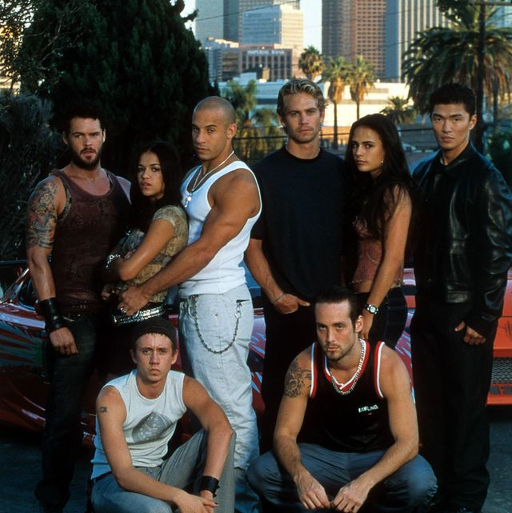

Thank you for the attention

